Slide 1
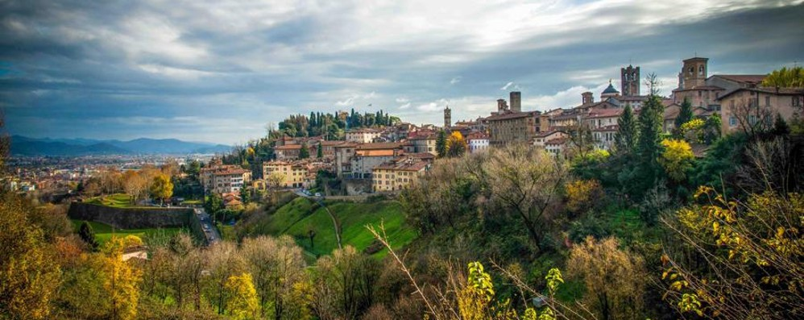
Heritage and ICT (Prof. Rossana Bonadei) Planning and Management of Tourism Systems, Dipartimento di Lingue, Letterature e Culture Straniere SEMINAR Dr. Sanja Iguman. Institute for Philosophy and Social Sciences- University of Belgrade Wednesday 24.11.2021, 2 p.m. – 5 p.m: UNESCO COMPANY TOWNS Fieldwork: World heritage site - Crespi d’Adda Thursday 25.11.2021, 10 a.m. – 1 p.m: URBAN HISTORIC LANDSCAPES Itinerant lecture- Reading transnational signs in Bergamo- The Venetian fortifications

